Slide 1
Turning 12 Years of Accident Data into Safer French Roads
Data Consultant Briefing to the French Government | BAAC national accident records, 2005 to 2016
The Problem
The Opportunity
Lives still lost every day. Despite a decade of policy effort, road accidents in France still claimed 3,655 lives in 2016. That is roughly 10 deaths every single day.
Progress has slowed. Accidents declined 33% between 2005 and 2013, but the downward trend has plateaued since 2013, and fatalities have risen again (3,427 in 2013; 3,655 in 2016).
Resources are allocated too broadly. Enforcement, infrastructure, and campaign budgets are allocated broadly, while the data shows risk is highly concentrated in specific roads, hours, and user groups.
The cost is huge. Beyond the human toll, road accidents cost France an estimated tens of billions of euros per year in medical care, lost productivity and infrastructure damage.¹
A rich national dataset. 839,985 recorded accidents, 1.87 million involved persons and 1.43 million vehicles (2005 to 2016), with location, time, road, weather, vehicle and casualty detail.
Target where the risk concentrates. Analytics can pinpoint where, when and for whom risk is highest, so every enforcement euro is spent where it saves the most lives.
The mission. Identify the highest-impact risk factors and translate them into targeted, measurable interventions to restart the decline in road deaths.
Key question
“Where is the risk actually concentrated and what should we do?”
¹ ONISR (Observatoire national interministériel de la sécurité routière) estimates of the annual socioeconomic cost of road accidents in France.
All other figures are computed from the BAAC dataset (Kaggle, ahmedlahlou/accidents-in-france-from-2005-to-2016).

Slide 2
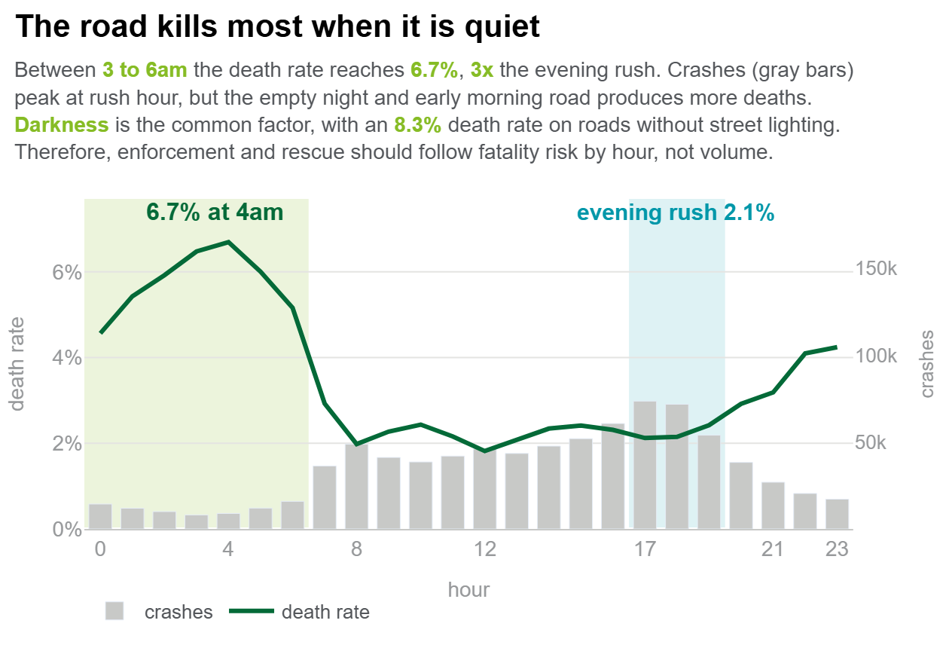
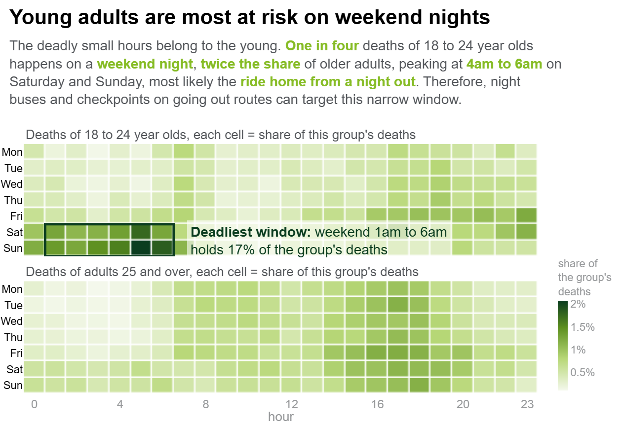
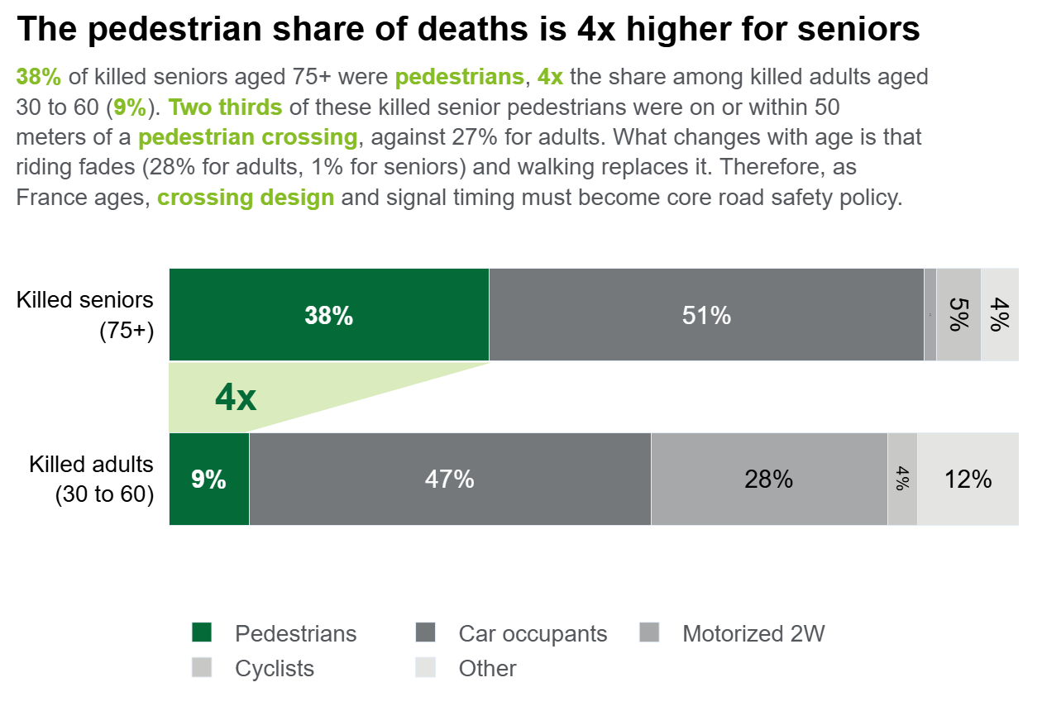
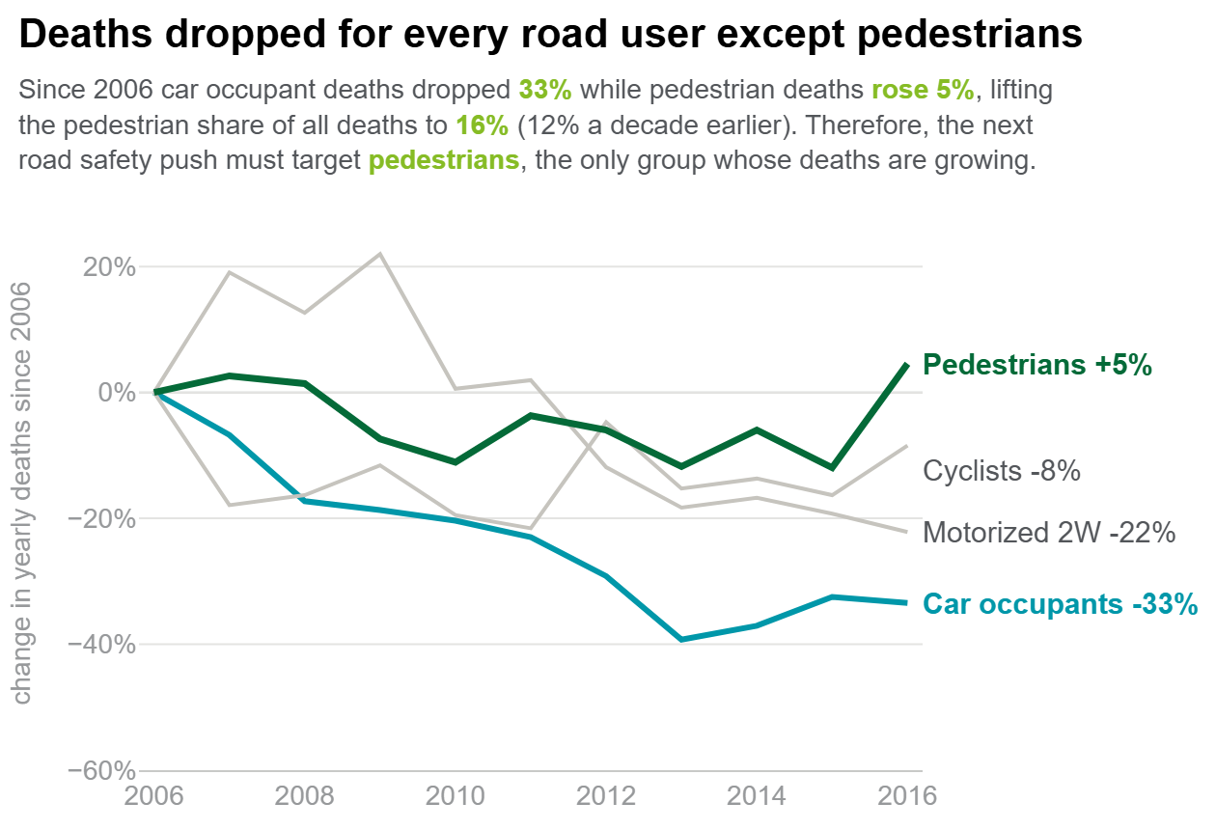
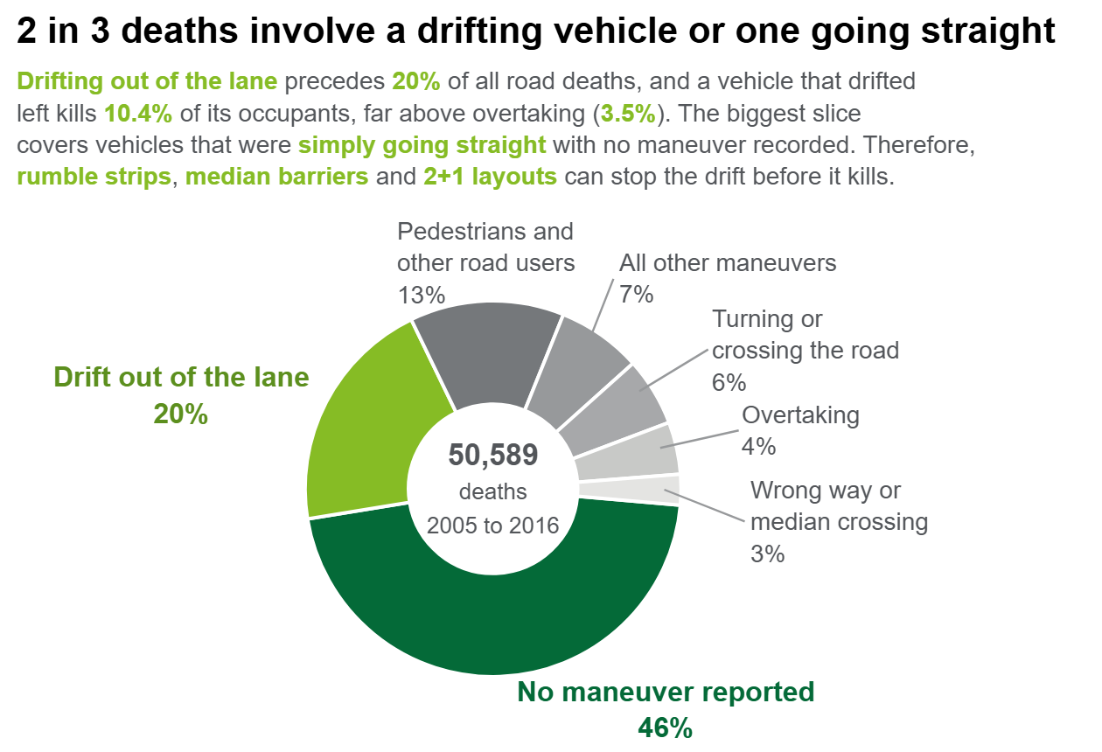
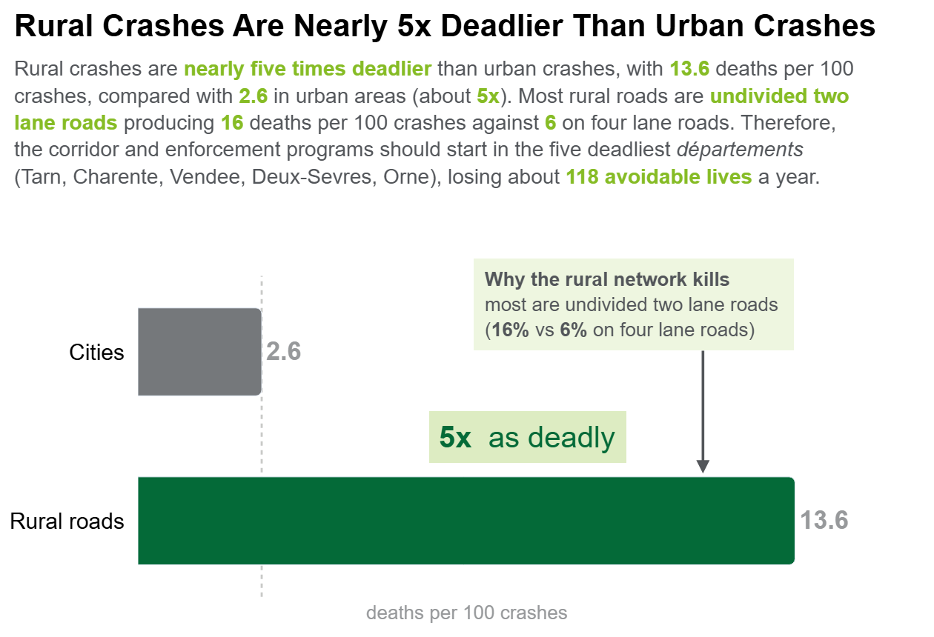
Six Insights That Should Redirect France's Road Safety Spending
Stats: 839,985 accidents · 1,876,005 involved persons · 50,589 deaths
RECOMMENDATION: (1) Set night and weekend enforcement windows plus night transport on hang out routes. (2) Upgrade the deadliest rural roads with median barriers, rumble strips, and 2+1 layouts. (3) Protect pedestrians with lower town speed limits, safer crossings, and signal timing for an aging population. (4) Focus and fund more on accident severity, not volume.

